Slide 1
Chillomania’s
Digital Strategy
By: Shruti, Ricardo & April
Intro
User Journey
Online Marketing Components
MarTech Stack
Conclusion

Slide 2
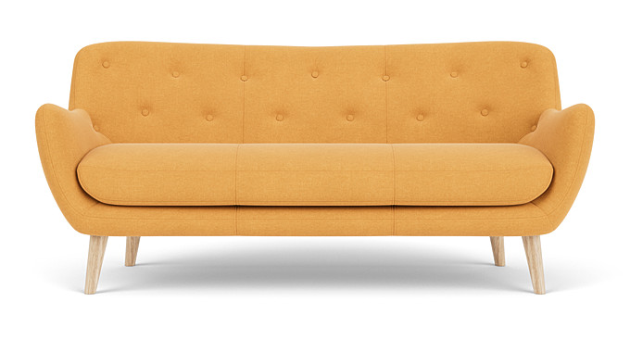
Chillomania profile
A company offering European designed and made furniture through distribution partners.
Will launch our own online store and increase overall sales.
Would like to set up an online marketing strategy that can be managed by Belinda.
Intro
User Journey
Online Marketing Components
MarTech Stack
Conclusion

Slide 3
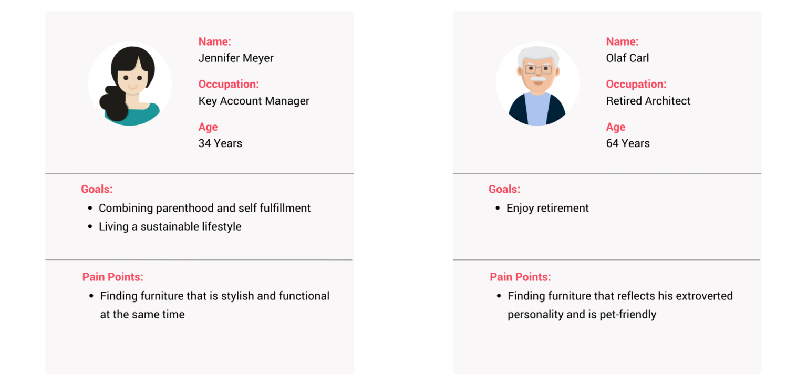
Chillomania’s User: Jennifer (34)
Awareness
Consideration
Advocacy
Purchase
Retention
“I need a new couch. This one is gross! This stain here is for two years now”.
“I am getting a bonus at work: it’s FINALLY time to buy a good couch”.
“I need this couch! It’s stylish, strong enough for my kids, and a ecologically conscious purchase”.
“Wow! I love this couch. And the family really likes it. But what if I do get a stain on it?”..
“The couch is great and the service is super! I highly recommend Chillomania!”
Word of mouth, social media, websites.
Search engines, websites, comparison & reviews pages
Chillomania online store, payment platform, delivery tracking, billing
Email, social media,
satisfaction survey, reviews
Product reviews, company review, social media
Intro
User Journey
Online Marketing Components
MarTech Stack
Conclusion

Slide 4
Chillomania User: Olaf (64)
Awareness
Consideration
Advocacy
Purchase
Retention
“I need a couch that’s stylish enough for me and my little Princess”.
“This is THE couch! I can’t wait to for my next dinner guests to see it!”.
“The couch doesn’t quite fit the room, it’s comfortable, though. Should I return it?”.
“The couch is great, and the service is super! I highly recommend Chillomania!”.
“New me, new couch! Let’s start my retirement with a refresh”.
Blogs, social media, listings, company website, word of mouth
Online store Chillomania, payment method, delivery tracking, billing
Chillomania website (testimonial), social media, word of mouth
Search engines, social media, websites, blogs, word of mouth
Email, customer service support, satisfaction survey
Intro
User Journey
Online Marketing Components
MarTech Stack
Conclusion

Slide 5


Online Marketing Components
Social Media
Blog
Company Blog on the Website
Search Engines
Text Search
Product Search
Image Search
Ad
Video
On Website
Website
Chillomania Website
Reviews
Testimonial’s on website
Company reviews on Google
Intro
User Journey
Online Marketing Components
MarTech Stack
Conclusion

Slide 6
Building a MarTech Stack for Growth
Content
Measurement
Data
Relationship
Content creation: Jasper.ai, ChatGPT
Content optimization: Screaming Frog, Google Trends, Google Keyword Planner
Content distribution: WordPress, Shopify, Buffer, Mailchimp
Web/App tracking: Google Analytics
Ad performance tracking:
Google Ads
Tag management system:
Google Tag Manager
Visualization & Reporting:
Google Big Query, Google Looker Studio
Analysis:
Google Sheets
Data-driven actions & decisions:
Google Optimize, Google Performance Max
CRM:
Pipedrive
Chatbot:
ChatBot
Online reputation: Google Alerts
Intro
User Journey
Online Marketing Components
MarTech Stack
Conclusion

Slide 7
Achieving goals strategically
Business expansion empowered by digital experts and tools:
Chillomania’s amazing products
+
The right online marketing strategy
=
Increased sales & diversified sales points
Intro
User Journey
Online Marketing Components
MarTech Stack
Conclusion

